Slide 1
AI-Driven Drug Screening for solving Substance Abuse
Adhvik Chakraborty
Semester 1, Block 1
January 17, 2025
David Thompson Secondary School

Slide 2
Table of contents
01
04
02
05
03
06
Abstract & Introduction
Materials & Procedure
Background Info
Data & Analysis
Lab Question, Hypothesis, Purpose
Future Improvements and Conclusion

Slide 3
01
Abstract & Introduction

Slide 4
Abstract
The opioid use disorder (OUD) crisis, driven by unregulated synthetic opioids, has caused a significant number of drug-related deaths in British Columbia, particularly in Vancouver, placing a heavy burden on public health and safety.
The BC Coroners report emphasizes the urgent need to develop safer opioid alternatives to combat this public health emergency.
Opioids primarily target MOR, DOR, and KOR receptors in the brain but can also affect other critical proteins, leading to side effects.
This project addresses the OUD problem by screening and identifying known drugs (drug-repurposing) that can serve as a safer alternative to the existing opioids by lowering side-effects and overdose risks
The central idea is to elucidate the complex effect of a drug by developing reliable machine learning models of the opioid receptors and their PPI network to predict the binding of a drug to various interacting proteins in the body.
Screening 11,915 drugs revealed safer opioid substitutes, customized for various health conditions, empowering clinicians with flexible treatment options and supporting the BC Coroners report's recommendations.

Slide 5

Introduction
Opioid Use Disorder (OUD) is an urgent and escalating global epidemic, demanding immediate attention and action
Approximately 40 million people globally suffered from drug use disorders
It is estimated that as many as 225,000 people in BC remain at risk of unregulated drug injury or death.
At least 32,632 Canadians died from an opioid overdose between January 2016 and June 2022.
In Vancouver’s Downtown Eastside, unregulated drug toxicity has led to a death rate over 12 times the provincial average, with fentanyl found in more than 85% of overdoses
BC Coroners Review Panel suggested creating access to sufficient and safe alternatives for the drug dependent people as a short-term solution

Slide 6
02
Background Info

Slide 7
Background Info
Current remedies for Opioid Use Disorder (OUD) are limited in effectiveness. Machine learning can assist in developing new solutions by repurposing drugs originally designed for other purposes.
Protein-drug binding involves interactions between a drug (ligand) and a specific protein site, driven by forces like hydrogen bonds and ionic interactions. Understanding these interactions is critical for designing effective, targeted therapies.
AutoDock Vina predicts the binding affinity between drug candidates and target proteins. Its ability to handle flexible ligands and receptors facilitates realistic simulations, making it a valuable tool for virtual screening and drug discovery.
The main opioid receptors (MOR, KOR, DOR, and NOP) mediate the body's response to pain, mood, and other physiological processes. MOR is a key target for pain relief but is also linked to addiction and adverse effects.
Opioid agonists activate receptors to produce effects like pain relief, while antagonists block these receptors, preventing activation and mitigating opioid effects.
ML, a subset of AI, analyzes data patterns to enable predictive capabilities. Techniques like regression and decision trees model relationships between features and targets, with Random Forest Regressor excelling in non-linear data.
PPI networks map interactions between proteins, aiding in understanding cellular mechanisms and disease pathways. These networks are crucial for identifying drug targets and understanding their effects.
The hERG gene is vital for heart function. Safe drugs must have low binding affinity to hERG to avoid serious cardiac side effects like arrhythmias.

Slide 8
03
Lab Question, Hypothesis, Purpose

Slide 9
Lab Question, Hypothesis, Purpose
Lab Question
Hypothesis
Purpose
Can an efficient machine learning technique be developed to identify safer alternatives to current opioids that have reduced side effects, and overdose risk for individuals with Opioid Use Disorder (OUD)?
If reliable machine learning models are built that can predict the binding between drugs and different proteins associated with the opioid receptor in the human body then, it is possible to find existing drugs that are safer substitutes to the existing opioids.
The purpose of this project is to leverage machine learning to repurpose existing drugs, offering healthcare providers a broader range of cost-effective treatment options tailored to individual medication needs, thereby taking a step towards the implementation of the BC Coroners' recommendation.

Slide 10
04
Materials & Procedure

Slide 11

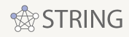


Materials
Hardware
Software
Data
PC/Laptop
Internet Connection
AutoDock Vina - (https://vina.scripps.edu/)
Molecular Fingerprinting (https://github.com/ChenDdon/AGBTcode)
Python Packages
Scikit Learn
Numpy
Pandas
Joblib

Slide 12
Procedure: Part 1 - Understanding binding of proteins and ligands
To better understand Protein-ligand binding AutoDockTools and AutoDock Vina is used to predict binding affinities between proteins and ligands.
1. Install Necessary Software (AutoDock Vina, AutoDockTools, and PyMOL)
2. Download Mu opioid receptor from PDB (PDB ID: 5C1M)
3. Download Ligands from PubChem (Aspirin, Fentanyl, and Buprenorphine)
4. Prepare MOR using AutoDockTools
5. Prepare the ligands using PyMOL and AutoDockTools
6. Run AutoDock Vina using this command in command prompt: vina.exe --receptor MOR.pdbqt --ligand Fentanyl.pdbqt --config config.txt --log log.txt --out output.pdbqt
7. Repeat step 6 for each ligand with MOR

Slide 13
Procedure: Part 2 - Developing ML Models to predict binding of proteins and ligands
ML Training Data Collection
ChEMBL is used to download the training data necessary for our model
Go to ChEMBL and search the protein name (e.g. “Mu opioid Receptor”)
Select the protein with the type “SINGLE PROTEIN” and organism as “Homo sapiens” (e.g. CHEMBL233 for MOR)
Scroll down to Approved Drugs and Clinical Candidates and download all compounds.
The data contains the SMILES representation of the ligand and its binding affinity with the protein.

Slide 14
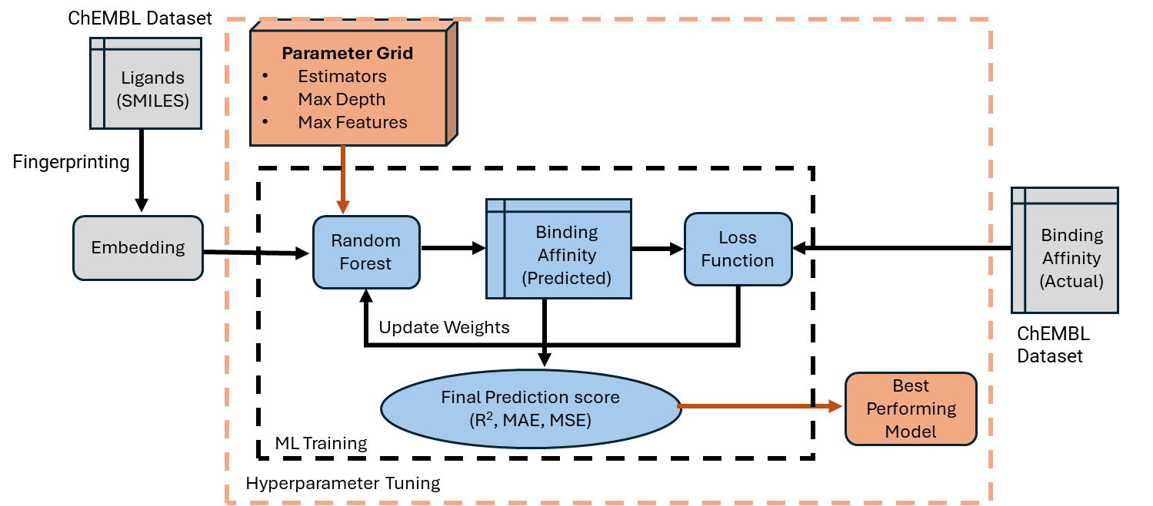
Procedure: Part 2 - Developing ML Models to predict binding of proteins and ligands
ML Model
To determine the most effective machine learning model, several regression-based algorithms were developed and trained on the dataset. Among them Random Forest Regressor was selected based on its better accuracy.
The next slide shows all the steps to build the machine learning models.

Slide 15
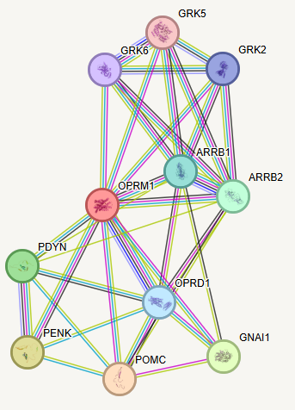
Procedure: Part 3 - Understanding the PPI network related to MOR
A PPI network maps interactions between proteins.
To find the best candidates, the screening should identify drugs with:
a high binding affinity with MOR
low binding affinities for the rest of the proteins in MOR’s PPI network.
The steps to get the proteins in MOR’s PPI network are listed below.
From the STRING website search up “Mu Opioid Receptor” and click continue. This will show all the proteins directly related to MOR.
The figure to the right shows the MOR PPI network. OPRM1’s alias is MOR, and the proteins directly connected are shown below.

Slide 16
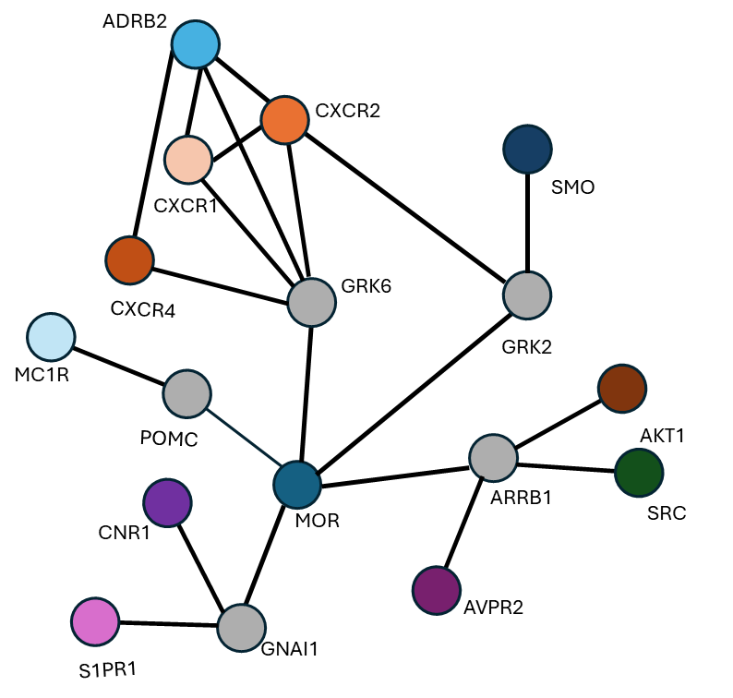
Procedure: Part 3 - Understanding the PPI network related to MOR
The ML training dataset for proteins directly linked to OPRM1/MOR was unavailable.
To address this, the PPI network was expanded to include proteins with accessible training data.
Grey circles in the graph represent proteins without available data.
ML models were developed for the remaining proteins: AVPR2, ADRB2, AKT1, CNR1, CXCR1, CXCR2, CXCR4, MC1R, S1PR1, SMO, and SRC.
An ML model was developed for hERG, which regulates heart rhythm.
Blocking it can cause arrhythmias or heart attacks, so drugs must have a "low" binding affinity.

Slide 17
Procedure: Part 4 - Drug Screening
Repurposing drugs as opioid alternatives requires selecting those with high MOR binding affinity for similar euphoric effects and low binding affinity with other proteins for improved safety
Go to DrugBank to download all known drugs to screen for potential safe drugs.
For each drug extract the SMILES strings and convert them into molecular fingerprints as explained in part 2.
Using each drug’s molecular fingerprint, the protein ML PPI models predicts the corresponding binding affinities.
The proteins are prioritized from most to least important for screening, as shown in the table below.
Filter all drugs that have a “High” MOR binding.
Further filter the drugs that have “Low” hERG binding as it interferes with the heart’s activity.
Next, filter the drugs that have “Low” CXCR4 binding (involved in cancer metastasis, HIV infection, and immune response.)

Slide 18
Procedure: Part 4 - Drug Screening
Customized screening of drugs based on health conditions
Health Condition of person with OUD | Proteins with “Low” binding affinity with the drugs
Diabetes | CNR1: May exacerbate weight gain and appetite dysregulation, worsening metabolic control.
Cardiovascular Diseases | CNR1: Can alter central nervous system activity, impacting cardiovascular regulation.
Cancer | AVPR2: Can lead to water retention issues, complicating chemotherapy side effects. ADRB2: May promote cancer cell migration in specific tumor types.
Neurological Disorders | CXCR1/CXCR2: Excessive immune modulation can exacerbate neuroinflammation.
Autoimmune Diseases | MC1R: Pigmentation effects are irrelevant and could cause unnecessary side effects.

Slide 19
Procedure Part 4: Drug Screening
MOR PPI Network ML models
Drug bank List
(SMILES)
SMO
Fingerprinting
…
hERG
List of Safe Drugs
Drug Screening
Embedding
AKT1
SRC

Slide 20
05
Data & Analysis

Slide 21
Data & Analysis: Part 1 - Understanding binding of proteins and ligands
Three drugs that are known to bind strongly (Buprenorphine and Fentanyl), and weakly (Aspirin) are selected
The table below displays the results for MOR with Aspirin, Fentanyl, and Buprenorphine using AutoDock Vina
AutoDock Vina provides several potential binding affinity predictions.
The minimum and maximum values of these predictions are shown below.
Binding affinity of these drugs as available from Chembl is included to compare against AutoDock vina value
Range of binding affinity predictions for Aspirin and Fentanyl is around 0.2-0.4.
Range for Buprenorphine is significantly wider, with a difference of 1.8, suggesting lower confidence in its binding affinity prediction
Drugs | Binding Affinity using AutoDock Vina | Binding Affinity from Chembl
Aspirin | Maximum Binding Affinity: -5.5 Minimum Binding Affinity: -5.3 | N/A
Fentanyl | Maximum Binding Affinity: -7.1 Minimum Binding Affinity: -6.7 | -8.7
Buprenorphine | Maximum Binding Affinity: -7.5 Minimum Binding Affinity: -5.7 | -12.5

Slide 22
Data & Analysis: Part 2 - Developing ML Models to predict binding of proteins and ligands
To help identify the optimal model for the prediction of ligands binding to proteins.
The top three regression-based models: Linear Regression, Bayesian Ridge, and Random Forest are compared.
The performance was measured using the scoring methods: MAE, MSE, and R^2.
Linear Regression: An error range of 6.7% -18.2% .
Bayesian Ridge: An error range of 6.4% -17.5%.
Random Forest: An error range of 5.9% -16.1%.
Random Forest achieves the best performance, indicating the highest accuracy in predicting binding affinities.

Slide 23
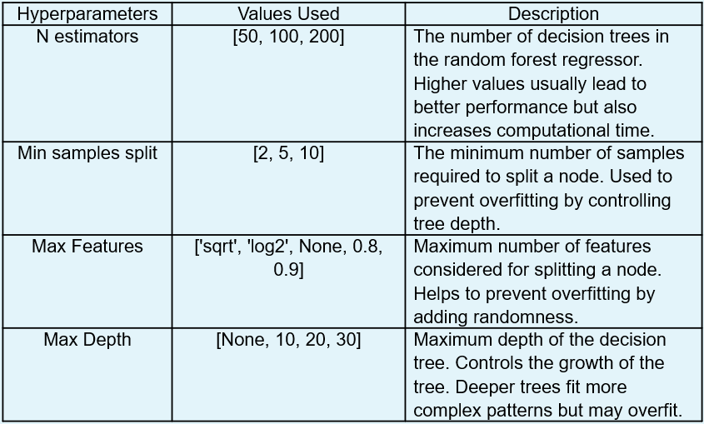
Data & Analysis: Part 2 - Developing ML Models to predict binding of proteins and ligands
To further improve the ML model for MOR, Hyperparameter tuning was used.
It finds optimal hyperparameters that would increase the accuracy and efficiency of the ML models.
The table to the right shows the details of the hyperparameters used.

Slide 24
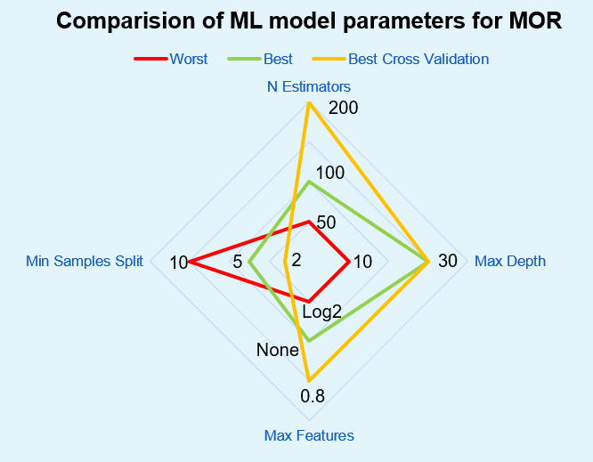
Data & Analysis: Part 2 - Developing ML Models to predict binding of proteins and ligands
A spider chart is created showing the hyperparameters of the worst and best scoring models and a model using cross validation.
Best model: 100 estimators, max depth of 30, min samples split of 5, max features = none.
Worst model: 50 estimators, max depth of 10, min samples split of 10, max features = log2.
Cross-validation model: 200 estimators, max depth of 30, min samples split of 2, max features = 0.8.
Performance improves with more trees (N Estimators), peaking around 100.
Both top-performing models Depth of 30 enables accurate binding affinity predictions.
High feature count improves accuracy.
Lower values for min samples split result in better performance.

Slide 25
Data & Analysis: Part 2 - Developing ML Models to predict binding of proteins and ligands
The bar graph shows the performance of the MOR random forest model with various hyperparameters and cross validation.
The lowest-performing model is significantly worse than the others.
The best-performing model and the cross-validation model have nearly identical results across all three-evaluation metrics.

Slide 26
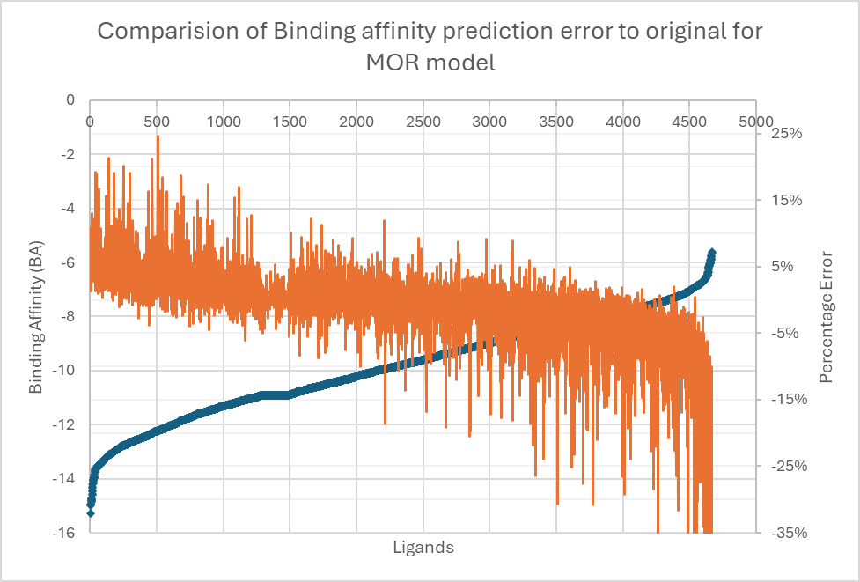
Data & Analysis: Part 2 - Developing ML Models to predict binding of proteins and ligands
Scatter and line plot illustrating the error in prediction of the binding affinities of the MOR ML model and various ligands.
The blue scatter plot depicts the actual binding affinities (left y-axis) whereas the orange scatter plot represents the corresponding prediction errors (right y-axis)
For the majority of the ligands (78%) the prediction error is within 5%
Another 19% of ligands have a prediction error of between 10 -15%.
Very few ligands have a large prediction error with maximum of 68%
Ligands with high binding affinities have positive prediction error percentages while low binding affinity have prediction error percentages that are negative
Actual Binding Affinities
Prediction Errors

Slide 27
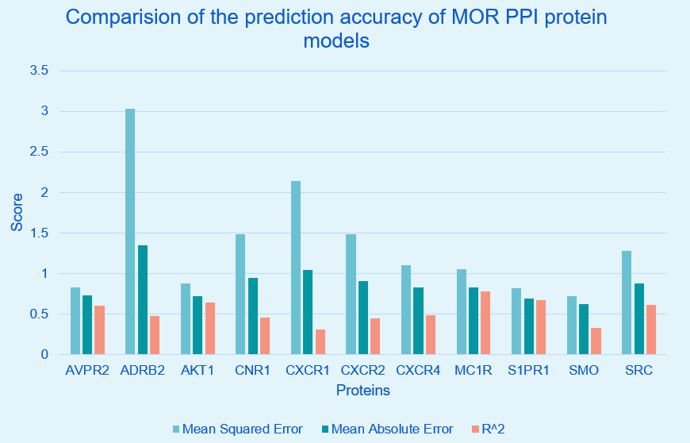
Data & Analysis: Part 3 - Understanding the PPI Network related to MOR
Evaluation results of the models of the proteins in MOR’s PPI network.
Evaluation metrics used were MSE, MAE, and R2.
Most proteins exhibit relatively good scores, except for ADRB2.
The high MSE indicates that the model made large errors on a few predictions but was accurate for most of them.
Some of the best-performing protein models include SMO, S1PR1, AVPR2, and AKT1.

Slide 28
Data & Analysis: Part 3 - Understanding the PPI Network related to MOR
The MOR PPI models predicted binding affinities for Health Canada approved opioids, categorized as "High", "Medium“ and "Low" Results are shown in the figure.
All drugs bind strongly to MOR, their target receptor, and to AVPR2, CXCR2, CXCR4, S1PR1, and SMO.
High binding affinities suggest side effects like swelling, dizziness, chronic inflammation, cancer growth, and organ damage.
The clinically known harmful side effects of these drugs are quite similar to the predicted side effects listed above.
This illustrates that the ML models are very reliable, for the drug screening purposes.

Slide 29
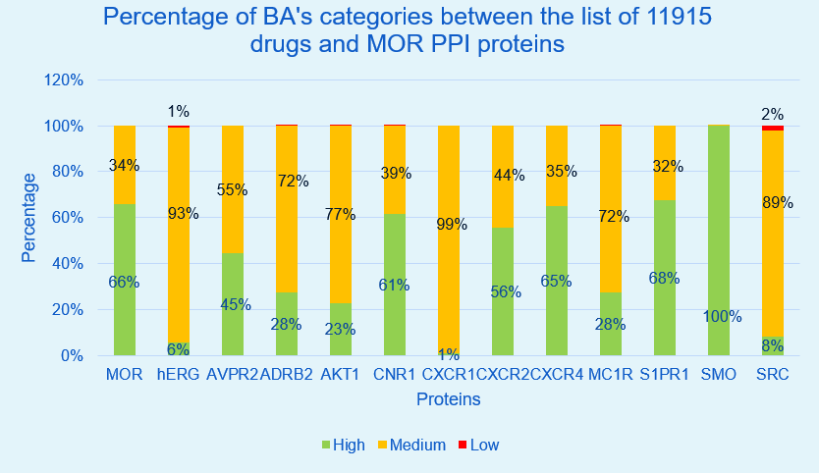
Data & Analysis: Part 4 – Drug Screening
DrugBank drug list was screened by predicting the binding affinity of each drug to the MOR PPI proteins
The bar graph illustrates the percentage distribution of the binding affinity categories for each protein.
Except SRC and hERG with low binding percentages of 2% and 1% respectively, no other proteins have drugs with predicted low binding.
For MOR, 60% of the predictions indicated high binding affinity, with the remaining 40% falling in the medium range.

Slide 30
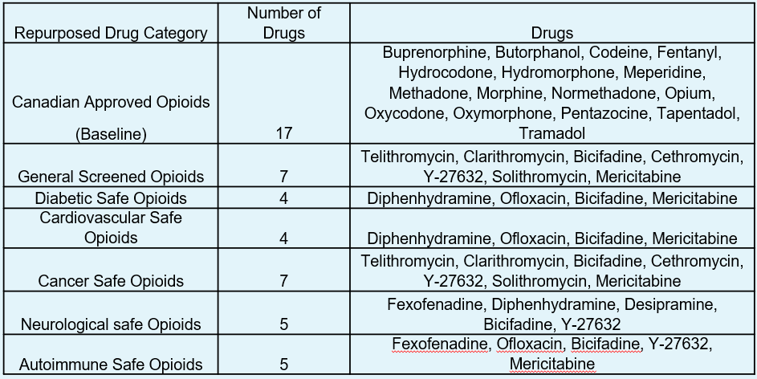
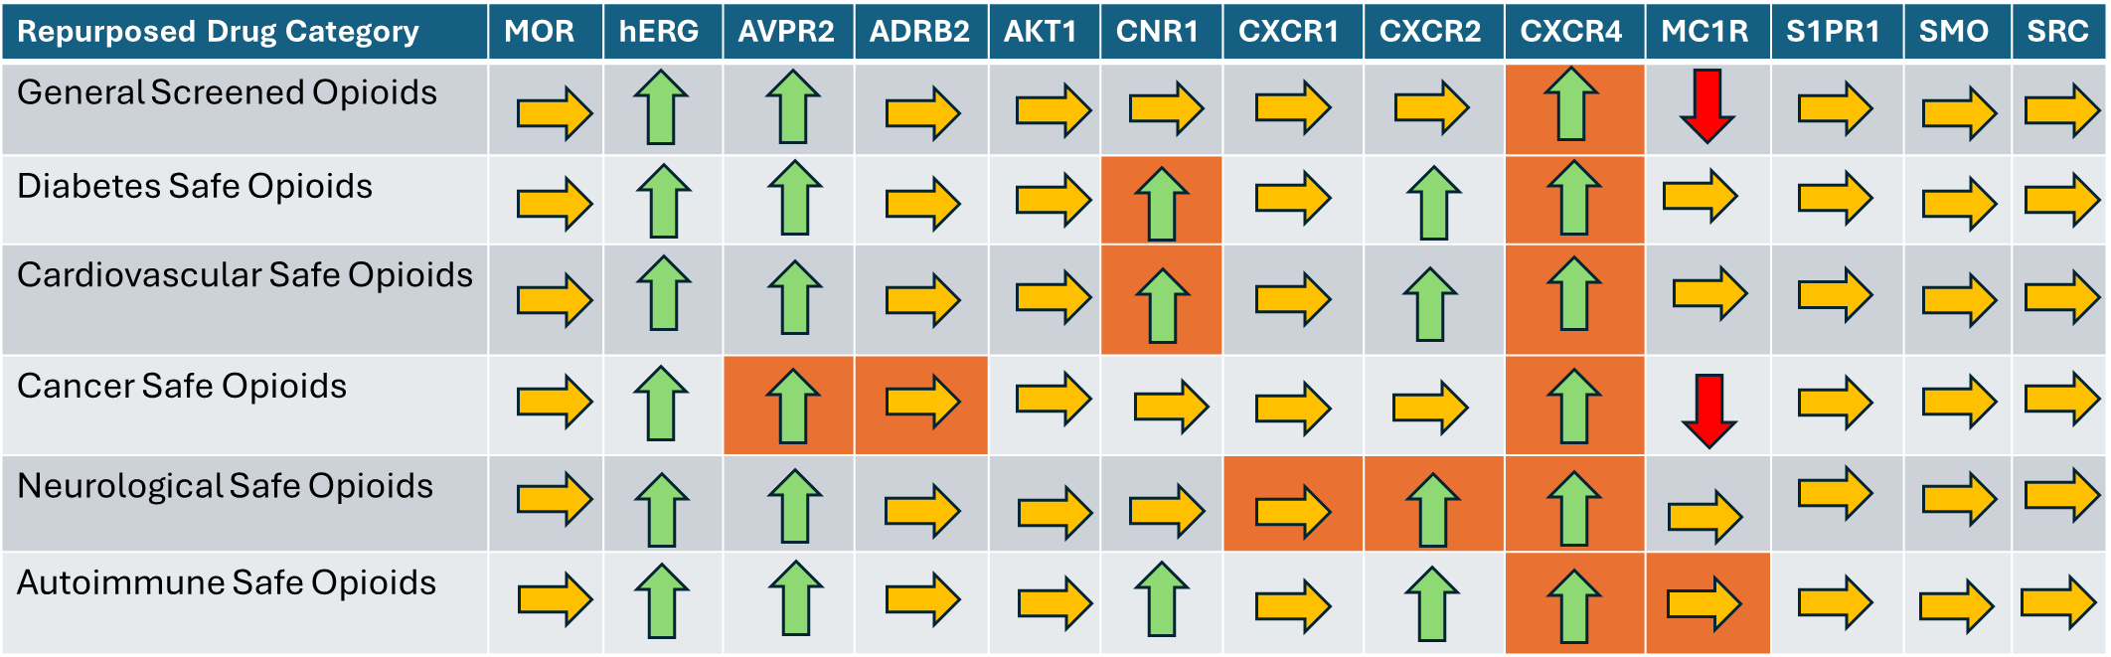
Data & Analysis: Part 4 – Drug Screening
Binding affinities between 11,915 drugs and MOR PPI proteins were predicted and categorized.
A screening technique was implemented to identify safer alternatives to existing opioids.
Drugs were screened and filtered to have:
high binding affinity with MOR
low binding affinity with CXCR4 and hERG
Based on common health conditions specific proteins were targeted
Top-right table shows the screened opioids that are safer than Health Canada-approved opioids.
The bottom-right table shows improvements in vital proteins such as hERG, AVPR2, CNR1, CXCR2, and CXCR4.
The newly screened drugs demonstrate reduced side effects compared to current opioids.

Slide 31
06
Future Improvements and Conclusion

Slide 32
Conclusion
In this project, a novel approach leveraging machine learning models to understand a drug's effects on the human body through the PPI network was proposed and successfully implemented. The results supported the hypothesis, demonstrating that machine learning can effectively identify safer alternatives to existing opioids. By applying this method to screen known drugs, the project highlighted its potential to combat opioid use disorder (OUD) by providing a safer and more effective solution to this global health crisis.

Slide 33
Sources of Error
Incomplete or inaccurate SMILES strings and PPI protein information from databases like DrugBank, PDB, and ChEMBL could have introduced errors in predicting binding affinities.
Errors in data processing, such as incorrect molecular fingerprint conversion, might have impacted the results.
Overfitting or underfitting the machine learning models may have reduced prediction accuracy, potentially invalidating the screening results.
Suboptimal hyperparameter tuning could have prevented the model from achieving optimal performance.
Assuming that low binding affinity directly correlates with clinical effectiveness overlooks important biological factors, such as drug behavior in the body and protein interactions.
Limitations like rounding errors or insufficient computational resources may have disrupted the training process.
Human errors during implementation or interpretation of results could have introduced additional inaccuracies.

Slide 34
Future Improvements
Future improvements aim to enhance the project in three key areas. First, the prediction accuracy can be significantly improved by developing transformer-based machine learning models. Second, the scope of the PPI network will be expanded by including additional opioid receptors, such as DOR and KOR, to provide a more comprehensive understanding of drug interactions. Lastly, the screening process will be refined by analyzing and incorporating drug toxicity and absorption properties.

Slide 35
References
Benyamin, R., Trescot, A., Datta, S., Buenaventura, R., Adlaka, R., Sehgal, N., Glaser, S., & Vallejo, R. (2008, March 1). Opioid Complications and Side Effects. Pain Physician. https://pubmed.ncbi.nlm.nih.gov/18443635/
Bhatti, A. (2020, April 17). Fentanyl Addiction In Vancouver | Andy Bhatti Interventions. Andy Bhatti. https://andybhatti.com/addictions/fentanyl-addiction-in-vancouver/
Bioinformatics With BB. (2020, July 30). Molecular Docking | Autodock VINA Virtual Screening | VINA Docking tutorial | Bioinformatics. YouTube. https://www.youtube.com/watch?v=tFFxNTvvoJI
Dhaliwal, A., & Gupta, M. (2023, July 24). Physiology, Opioid Receptor. PubMed; StatPearls Publishing. https://www.ncbi.nlm.nih.gov/books/NBK546642/
Feng, H., Jiang, J., & Wei, G.-W. (2023). Machine-learning repurposing of DrugBank compounds for opioid use disorder. Computers in Biology and Medicine, 160, 106921–106921. https://doi.org/10.1016/j.compbiomed.2023.106921
Fox, L. (2023, February 13). How AI Can Help Design Drugs to Treat Opioid Addiction. The Biophysical Society . https://www.biophysics.org/news-room/how-ai-can-help-design-drugs-to-treat-opioid-addiction
Khushaktov, M. F. (2023, August 26). Introduction Random Forest Classification By Example. Medium. https://medium.com/@mrmaster907/introduction-random-forest-classification-by-example-6983d95c7b91
Liu, Y. S., Kiyang, L., Hayward, J., Zhang, Y., Metes, D., Wang, M., Svenson, L. W., Talarico, F., Chue, P., Li, X.-M., Greiner, R., Greenshaw, A. J., & Cao, B. (2022). Individualized Prospective Prediction of Opioid Use Disorder. The

Slide 36
References
Canadian Journal of Psychiatry, 68(1), 54–63. https://doi.org/10.1177/07067437221114094
mgl-admin. (n.d.-a). Downloads. AutoDock Vina. https://vina.scripps.edu/downloads/
mgl-admin. (n.d.-b). Homepage. Mgltools. http://mgltools.scripps.edu/
Nyuytiymbiy, K. (2021, April 5). Parameters and Hyperparameters in Machine Learning and Deep Learning. Medium. https://towardsdatascience.com/parameters-and-hyperparameters-aa609601a9ac
OPRM1 protein (human) - STRING interaction network. (2024). String-Db.org. https://string-db.org/cgi/network?taskId=bOq6tL3uVdpQ&sessionId=b5sqoi5NkBCu&allnodes=1
Rutherford, G. (2022). Machine learning predicts risk of opioid use disorder for individual patients. Ualberta.ca. https://www.ualberta.ca/folio/2022/12/machine-learning-predicts-risk-of-opioid-use-disorder.html
Schrodinger. (2019). PyMOL | pymol.org. Pymol.org. https://pymol.org/2/
UNODC. (2023). World Drug Report 2023. United Nations : Office on Drugs and Crime. https://www.unodc.org/unodc/en/data-and-analysis/world-drug-report-2023.html
V=Bapat, S. (2020, March 20). Molecular Docking Tutorial: AUTODOCK VINA - PART 1. Www.youtube.com. https://www.youtube.com/watch?v=Sux91FJ3Xe8
Warren, D. K., Marashi, A., Siddiqui, A., Asim Adnan Eijaz, Pradhan, P., Lim, D., Call, G., & Dras, M. (2022). Using machine learning to study the effect of medication adherence in Opioid Use Disorder. PLOS ONE, 17(12), e0278988–e0278988. https://doi.org/10.1371/journal.pone.0278988

